Slide 1
A New Selection Strategy for Decomposition-based Evolutionary Many-Objective Optimization
Jun 12, 2019, Wellington
Shufen Qin¹, Chaoli Sun¹, Yaochu Jin², Lier Lan¹, Ying Tan¹
1 Department of Computer Science and Technology,
Taiyuan University of Science and Technology
2 Department of Computer Science,
University of Surrey, Guildford, GU2 &XH, UK
chaoli.sun.cn@gmail.com, chaoli.sun@tyust.edu.cn

Slide 2
Outlines
Motivation
The proposed method
Experimental results and discussions
Conclusion and future works

Slide 3












Motivation
Decomposition based
$$w_{0}$$
$$w_{0}$$
2
2
$$w_{1}$$
$$w_{1}$$
Convergence
1
1
Diversity
3
$$z_{1}^{∗}$$
3
4
$$w_{2}$$
4
$$w_{2}$$
$$z_{2}^{∗}$$
$$z_{3}^{∗}$$
$$w_{3}$$
$$w_{3}$$
$$z^{∗}$$
$$z^{∗}$$
$$z_{4}^{∗}$$

Slide 4
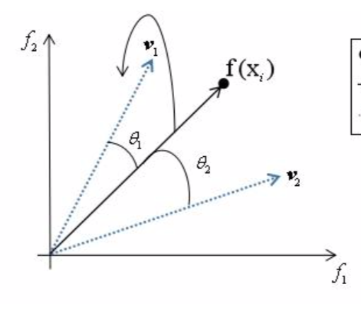
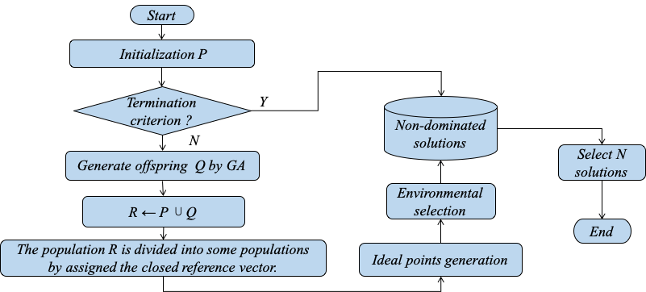
The flowchart of the DEA-NSS

Slide 5
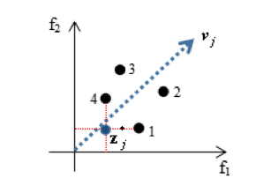
The flowchart of the DEA-NSS
5￼

Slide 6
The flowchart of the DEA-NSS
6￼

Slide 7
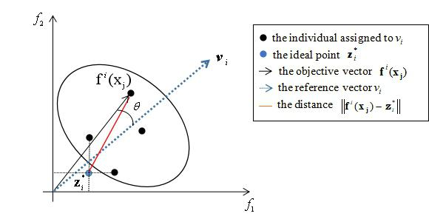
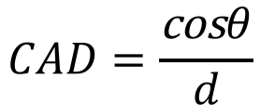
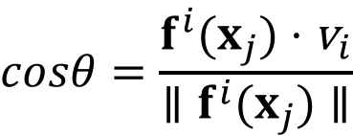

$$CAD=\frac{\text{cos}θ}{d}$$
$$cosθ=\frac{f^{i}(x_{j})⋅{\text{v}}_{i}}{∥f^{i}(x_{j})∥}$$
$$d=∥f^{i}(x_{j})−{\text{Z}}_{i}^{∗}∥$$

Slide 8
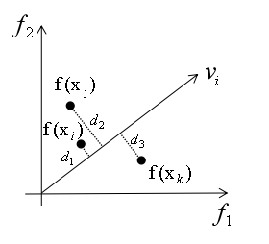
The flowchart of the DEA-NSS
8￼

Slide 9
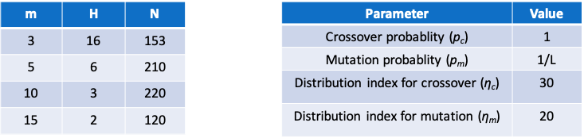
Experimental results and discussions
TABLE I Parameter settings
20 independent running

Slide 10
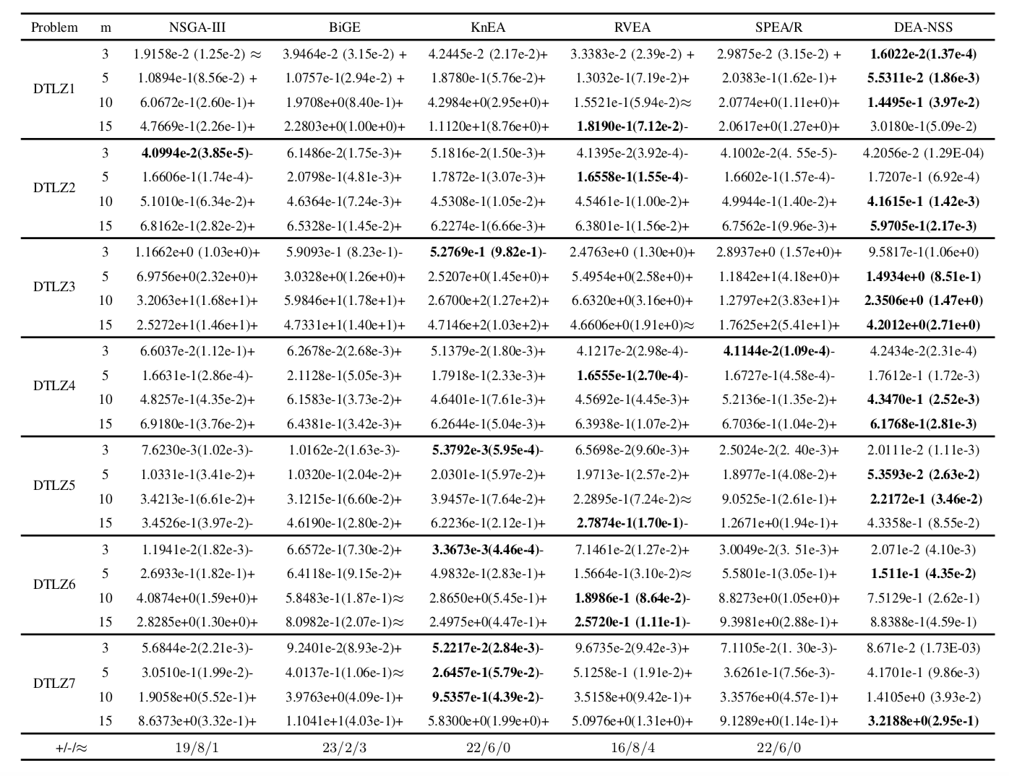

Slide 11
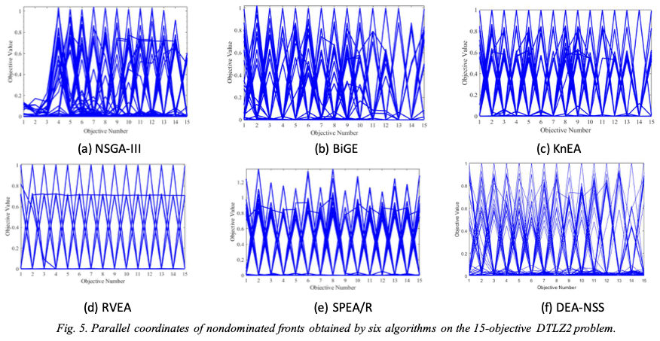
Experimental results

Slide 12
Conclusions and future works
Conclusions
Multiple ideal points are utilized
A new environment selection strategy was proposed
Future works
Use different methods to generate the reference vector as much as possible
Use other methods for the ideal points setting

Slide 13

Please contact me (chaoli.sun.cn@gmail.com) by email if you have any question or comments!

